Slide 1
Udacity Connect Session
February 24, 2018
Model Evaluation and Validation
Part One
github.com/zkhundkar/ConnectIntensive

Slide 2
Welcome!

Slide 3
Morning Schedule
10:00 - 10:30 | Housekeeping, Review of Last Session
10:30 - 11:15 | Warm-up exercises with pandas and matplotlib
11:15 - 11:30 | ML Workflow
11:30 - noon | Common Evaluation Metrics
© 2016 Udacity. All rights reserved.

Slide 4
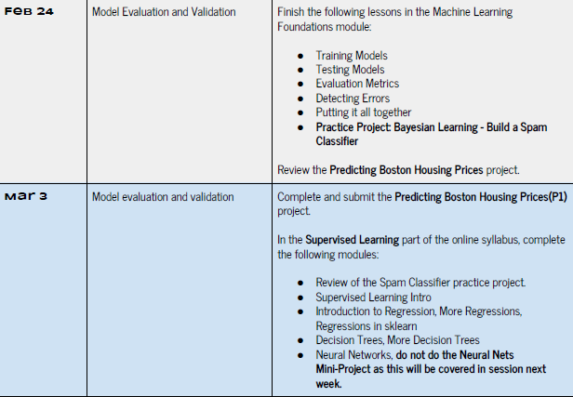

Slide 5
Additional Resources
CogswellGuest
dragon2016
IF YOU REALLY NEED TO HAVE A BOOK
Hands-on Machine Learning ... - Aurelion Geron
github.com/ageron/handson-ml
Python Machine Learning ... - Sebastian Raschka
github.com/rasbt/python-machine-learning-book-2nd-edition
Python for Data Analysis ... - Wes McKinney
© 2016 Udacity. All rights reserved.

Slide 6
Additional Resources
CogswellGuest
dragon2016
MUST EXPLORE ONLINE COMMUNITY
Kaggle -- Competitions, Datasets, Shared Notebooks
www.kaggle.com
KDNuggets -- Lots of learning resources, articles
www.kdnuggets.com
Quora, Reddit + many others
© 2016 Udacity. All rights reserved.

Slide 7
Review of Video Content
ML FOUNDATIONS REVIEW
Pre-Requisites
Some descriptive and Inferential Statistics
Knowledge of calculus and linear algebra
Programming in python
Models
Training
Testing
Evaluation Metrics
© 2016 Udacity. All rights reserved.

Slide 8
Numpy Review
DATA EXPLORATION
All data are represented as scalars or Numpy Arrays
Arrays can be many dimensional
Underlying functions optimized for vectorized math
The math and computations behind most ML libraries utilize Numpy or similar vectorized libraries.
© 2016 Udacity. All rights reserved.

Slide 9
Pandas Review
DATA EXPLORATION
Series and DataFrames
Allows us to easily add, edit, change columns or rows
Has built-in functions for reading and writing datafiles
Useful functions for getting a summary of the dataset
Functions for simple visualizations
© 2016 Udacity. All rights reserved.

Slide 10
Scikit-learn
MACHINE LEARNING ALGORITHMS
Essential library for python machine learning
The library is organized into several large packages
Can be overwhelming
Best to look at the documentation of each piece as you need it
© 2016 Udacity. All rights reserved.

Slide 11

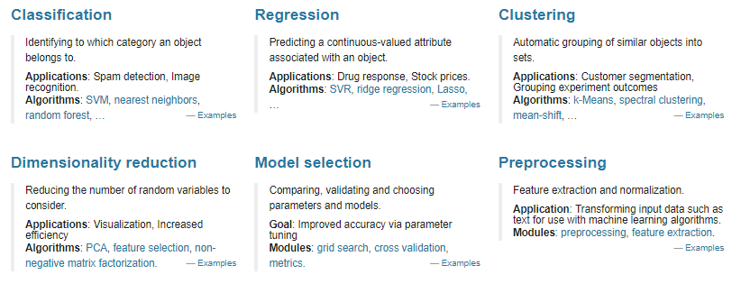
http://scikit-learn.org/dev/index.html

Slide 12
Matplotlib
DATA VISUALIZATION
Very rich library for displaying data and images
Lower level library -- therefore can be complex to work with
Seaborn provides a nice wrapper for many common visualizations on top of matplotlib
© 2016 Udacity. All rights reserved.

Slide 13
github.com/zkhundkar/ConnectIntensive/
02 python, numpy and matplotlib

Slide 14
Python - control structures
IF THEN ELSE
If <condition>:
…
elif <condition>:
…
else:
...
<value> if <condition> else <value>
© 2016 Udacity. All rights reserved.

Slide 15
Python - control structures
FOR , WHILE
for x in <iterable>:
…
break
while <condition> is True:
…
break
© 2016 Udacity. All rights reserved.

Slide 16
Python - data structures
TUPLE, LIST, DICT
list .. array or collection
tuple .. is an immutable array or collection
dict .. dictionary (hash table)
© 2016 Udacity. All rights reserved.

Slide 17
Python - dictionary
DICT
dict is a collection of key - value pairs
Dict[key] <value>
dict.keys() <list (key)>, dict.values() <list (value)>, dict.items() <list (tuple)>
Cannot sort a dictionary directly.
Sort keys then iterate over sorted list of keys
© 2016 Udacity. All rights reserved.

Slide 18
Python - comprehension
TUPLE, LIST, DICT
Compact way of writing a for .. loop
[chr(x) for x in range(65, 70)]
tuple(chr(x) for x in range(65, 70))
{chr(x):x for x in range(65, 70)}
© 2016 Udacity. All rights reserved.

Slide 19
github.com/zkhundkar/ConnectIntensive/
02a python, numpy and matplotlib

Slide 20
Machine Learning Workflow

Slide 21
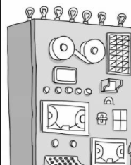
Cartoon View of ML Workflow
IN A NUTSHELL
In 50 years, there will be only 10 institutions in the world delivering higher education and Udacity has a shot at being one of them.
in higher being at years, the shot education of has 10 only will Udacity one be delivering In a 50 there and world institutions them.
SEBASTIAN THRUN
CEO: UDACITY

Slide 22
What is a “model”?
MODEL vs ALGORITHM
SVC(C=1.0, kernel=’rbf’, degree=3, gamma=’auto’, coef0=0.0, shrinking=True, probability=False, tol=0.001, cache_size=200, class_weight=None, verbose=False, max_iter=-1, decision_function_shape=’ovr’, random_state=None)
support_vectors_ : array-like, shape = [n_SV, n_features].

Slide 23
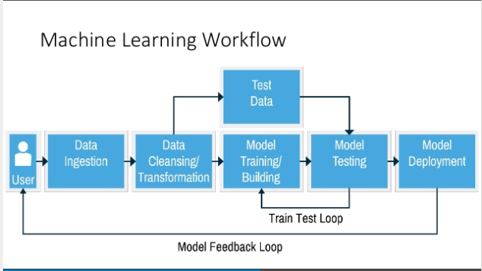
https://www.slideshare.net/TokyoAzureMeetup/tokyo-azure-meetup-11-introduction-to-azure-machine-learning
© 2016 Udacity. All rights reserved.

Slide 24
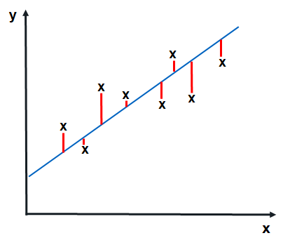
Performance Metric
REGRESSION
random - variance
y = ax + b
Total prediction error
Needs to be positive for both over-estimate and under-estimate
Shouldn’t depend on the number of samples

Slide 25

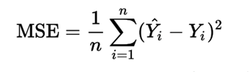
Performance Metric
REGRESSION y = ax + b
mean_absolute_error
mean_squared_error

Slide 26
R² score sklearn.metrics.r2_score
COEFFICIENT OF DETERMINATION
R² = (explained variation)/(total variation)
(mean_squared_error) / (mean_squared_deviation)
0 ≤ R² ≤ 1.0

Slide 27
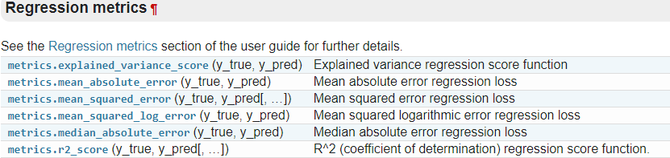
Regression Metrics

Slide 28
Revisit Notebook - section 3

Slide 29
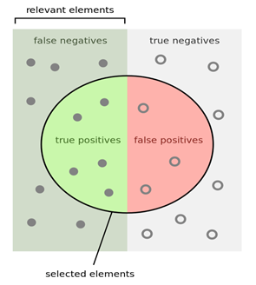
Classification Metrics
ACCURACY sklearn.metrics.accuracy_score
Accuracy Score
(Total correct)/(Total samples)
True Positives/All Samples

Slide 30
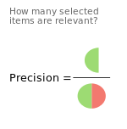
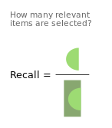
Metrics for Classification
PRECISION vs RECALL
Precision = TP/(TP + FP)
Recall = TP/(TP+FN)

Slide 31
Metrics for Classification
F1 Score = 2 * Precision * Recall / (Precision + Recall)

Slide 32
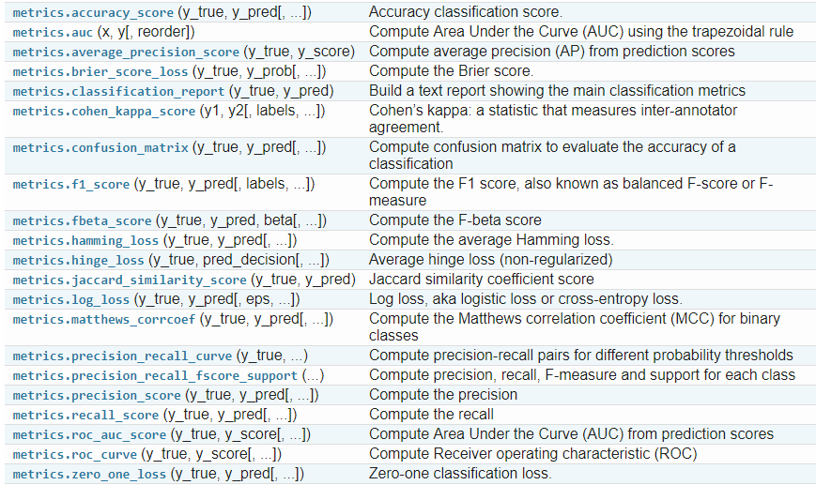
Classification Metrics - sklearn

Slide 33
Lunch Break
Lets meet back here at 1:00 pm

Slide 34
Afternoon Session
1:00 - 1:30 | Notebook Session 02 - Metrics playground Titanic Disaster Survivors revisited
1:30 - 2:00 | Bias and Variance
2:00 - 2:30 | Notebook Session - Bias and variance in project 0
2:30 - 3:00 | Recap, Lookahead and Feedback
3:00 - 5:00 | Boston Housing Project - (through question 5)
© 2016 Udacity. All rights reserved.

Slide 35
Model Fitting with sklearn
Generic plan
Import data – features and labels
Split data into test and train sets
Import library function
Create classifier, set parameters for model
Fit(train_features, train_labels)
Predict(test_features)
Score

Slide 36
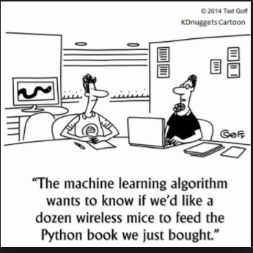
© 2016 Udacity. All rights reserved.

Slide 37
Goals of Performance Estimation
Estimate the generalization accuracy (future data).
Increase the predictive performance by tweaking the learning algorithm and selecting the best-performing model
Identify the machine learning algorithm that is best-suited for the problem at hand.
https://sebastianraschka.com/blog/2016/model-evaluation-selection-part3.html

Slide 38
Train-Test Split
MODEL EVALUATION
All Samples
Training set
Test

Slide 39
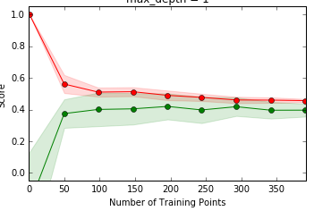
Learning Curves

Slide 40
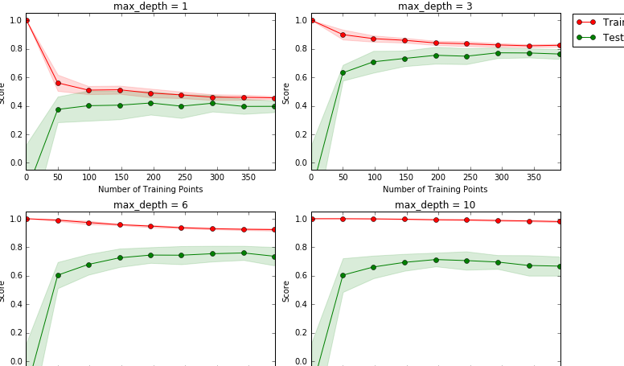

Slide 41
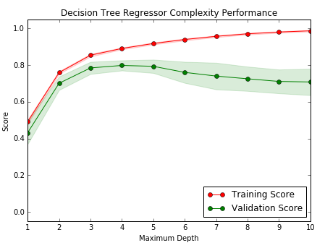
Complexity Curve
MODEL SELECTION OR HYPERPARAMETER TUNING

Slide 42
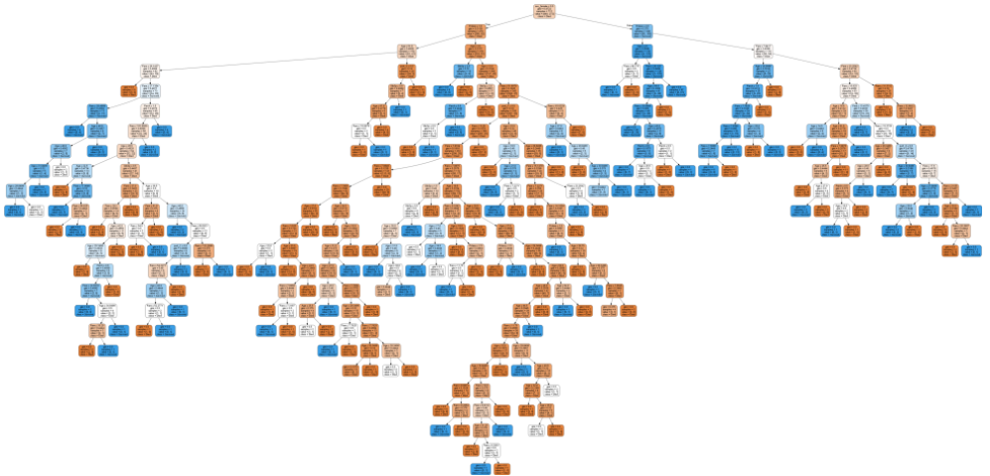
DecisionTreeClassifier (Overfitting)

Slide 43
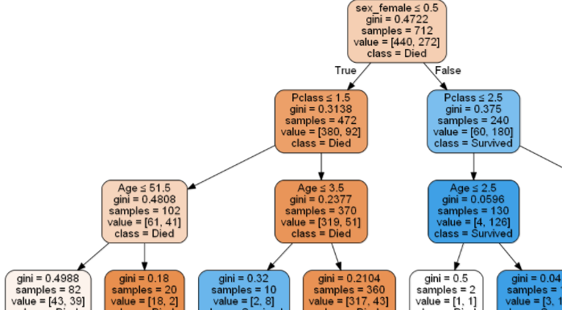
DecisionTreeClassifier (max_depth=4)
VISUALIZING ONE PART OF TREE

Slide 44
Prep for next week
Boston Housing Project
Complete Foundations Unit
Regressions in Supervised Learning Unit

Slide 46
Train-Test Split - Cross Validation
MODEL EVALUATION - PREVIEW OF CROSS-VALIDATION
All Samples
Training set
Test
Training set
Validation

Slide 47
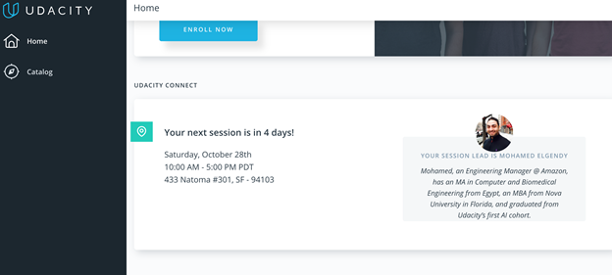
We really need your Feedback!
© 2016 Udacity. All rights reserved.

